Slide 1

Fertility Awareness and
Natural Family Planning
Encouraging fertility awareness while respecting God’s plan for love within marriage

Slide 2
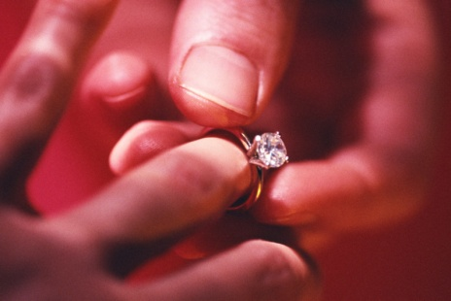
When You Marry
“Have you come freely,
without reservation?”
Free
Total
“Will you love and honor each other as man and wife for the rest of your life?”
Faithful
“Will you accept children lovingly from God?”
Fruitful
Notes:
On our wedding day, we promise to love our spouse in the same way Christ loves his Church.
Before we make our actual vows, we first have to give our consent. The priest asks us three questions:
[click]
Have you come freely, without reservation? – Our “yes” says that we are making a free gift of ourself, holding nothing back- total
[click]
Will you love and honor each other as husband and wife for the rest of your life? – Our “yes” says that we intend to be faithful to our dying day, never intending to divorce.
[click]
Will you accept children lovingly from God? – Our “yes” says that we intend to be fruitful, never intending to willfully sterilize our union.
What we say at the altar with our words we say in the bedroom with body language.
In fact, the Church explains that the vows we make at our wedding are sealed when we consummate our union in the marital embrace.
[click]
Marital union says with our body, “I give myself to you TOTALLY.”
(Explain why pre-marital sex is not truthful; does not seal any promise.)
Where does the Catholic Church fit in this?
The Church has always had a reverence for the Sacrament of Matrimony so much so that it has never changed its teaching about marriage. The teachings have always protected the vows a couple makes to each other and to the whole community. In respecting the importance of freedom it will never agree to marry a couple who feels forced to marry or will declare that a marriage was null and void as a sacrament (annulment) from the very beginning if a couple is found to have not possessed full freedom when they married.
(This freedom mirrors the freedom of our Creator as He chose to bring us into existence creating us to be a “gift” for others.)
The Church has always upheld fidelity in marriage and therefore condemns sins against lifelong faithfulness such as extramarital relationships. It likewise does not recognize the civil dissolution of the marriage or divorce.
(In making and living a commitment to fidelity for life, we show to our spouse and others an image of the unlimited faithfulness of our God to us.)
In marriage couples are asked to submit to one another and to love as Christ loved the Church. We make a “gift” of ourselves to our spouse. This highlights the totality of our self-giving that we are trying to attain. This means that we withhold nothing including our ability to bring a new life into existence.
(When Christ gave Himself to us, even to the point of death that we might live for eternity, He withheld nothing from us giving us a total “gift” of Himself.)
When the Church asks us to accept children, we are agreeing to be fruitful and that in our love-making we will do nothing prior to, during or afterwards to prevent a child’s conception when we unite as a couple.
(God’s love for us is fruitful as He calls each of us into existence and as He gives life to all around us.)

Slide 3








What is NFP?
Notes:
How many are familiar with NFP?
What have you heard about it?
Natural Family Planning is a method of fertility awareness in which an understanding of the natural cycles of fertility and infertility are taught. A couple who has learned this can then use that information responsibly deciding to either avoid pregnancy by abstaining from genital sexual activity during the fertile time or try to achieve pregnancy by engaging in sexual intercourse when fertile.
NFP is not Rhythm! Rhythm was used before a more scientific and better understanding of women’s fertility was known. Calculations were made by examining a woman’s history while NFP evaluates a current day by day fertility pattern. While it was a precursor of NFP it is not what we are now discussing.

Slide 4

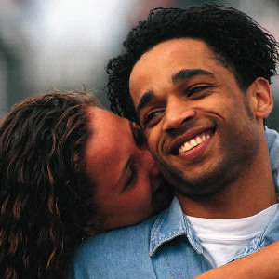


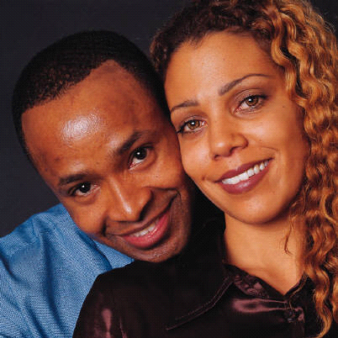
Who can use NFP?
Breastfeeding
Regular / Irregular
Menstrual Cycles
Achieving / Avoiding
Pregnancy
Pre-menopause
Post-hormone
Notes:
Natural Family Planning can be used by couples everywhere, in any stage of their reproductive life. You need not have regular cycles and it is applicable while breastfeeding when ovulation might be temporarily delayed as well as during the pre-menopausal time when cycles often change dramatically. Through daily monitoring of signs of fertility, couples evaluate whether or not conception could occur each day. NFP is not limited to just Catholic couples even though its use conforms to Catholic teaching. Women wishing to promote good personal health will tend to look to a method of family planning that has no side effects while allowing them to accomplish their goals. NFP is also inexpensive. After the initial costs of learning there are no other expenses other than for supplies such as thermometers, charts etc.

Slide 5
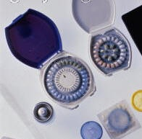
NFP is not Contraceptive
Notes:
NFP is not contraceptive. Contraceptives are mechanical, chemical or surgical means to prevent pregnancy, and in some cases, are actually abortifacients-meaning that they work to prevent the continuation of an early pregnancy that has already occurred. While NFP may have the same ends, or results as birth control, in the limiting of family size, no action is taken to withhold, suppress, alter or destroy either the man or woman’s reproductive function. Couples using NFP make the free choice not to engage in sexual relations when fertile if they do not intend to invite God to create a new life in that cycle.
So, even though the ends might be the same, the means are very different. (Ex. Stealing or working to buy food for your kids are different means to the same ends, but not morally equivalent…etc).

Slide 6





NFP works by…
Understanding Fertility
Observing Signs
Keeping Charts
Making Decisions Together
Abstaining / Engaging
Notes:
Understanding basic male & female fertility( knowing when you are fertile and when you are not
Observation of fertility signs in a woman’s body
Daily recording signs on chart
Deciding, as a couple to achieve or avoid pregnancy
Abstaining from, or engaging in, marital relations depending on your family planning intentions that cycle.

Slide 7

Develop Fertility Awareness
**Completing a certified course achieves
highest rate of effectiveness**
Notes:
Fertility Awareness is the key to NFP. Through a series of classes and one-to-one follow-up guidance, couples are taught to monitor and chart signs of fertility. From those charts they can determine which rules they should apply depending on their pregnancy intentions.

Slide 8
FABMs: Fertility Awareness Based Methods
1. Cervical Fluid (Ovulation Method)
a. Billings-most popular internationally
97+% effective
b. Creighton- most recommended for couples struggling with infertility 98+% effective
2. Cervical Fluid + Temperature (Sympto-Thermal) - 99+% effective
a. Couple to Couple League
b. SymptoPro
S-T Method - most popular form of FABMs in United States
*Effectiveness requires certified instruction.
*Kindara app is highly rated, with 1.6 million users

Slide 9
Reasons People Use NFP
Spiritual
Philosophical
Relational
Biological

Slide 10
Reasons To Take A Class
Learn about reproductive health
Confirm your personal signs of fertility
Infertility
1 in 6 couples experience subpar fertility
Inability to get pregnant (with frequent intercourse) for at least a year
10 – 18% of couples have trouble getting pregnant or having a successful delivery
⬆ after age 30 ⬆⬆ after age 35

Slide 11
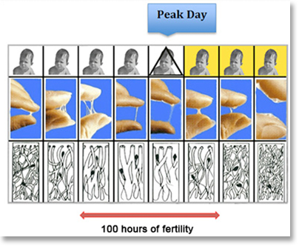
Typical Cervical Fluid

Slide 12
Ovulation and the Role of Cervical Fluid
Ovulation is the release of an egg from the ovary.
It occurs on one day each cycle.
The egg lives only 12 to 24 hours.
Sperm need cervical fluid to survive.
  Without it they die within hours.
  With good cervical fluid, sperm can live 3 to 5 days.

Slide 13
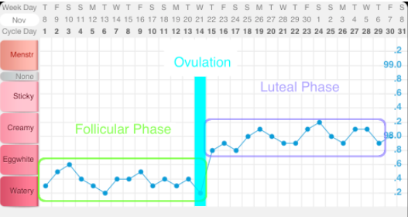
Typical Temperature Pattern

Slide 14
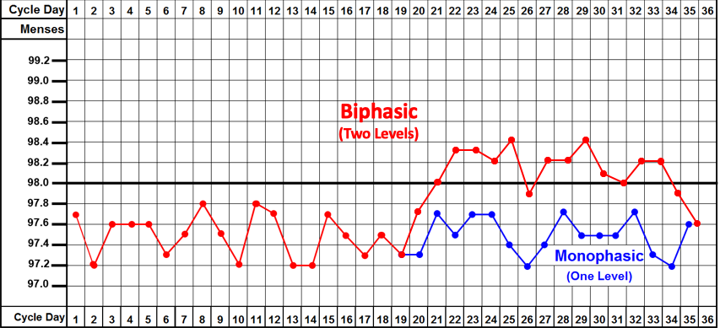
Check Your
Temperature Pattern
Do you have at least 10 high temps?

Slide 15
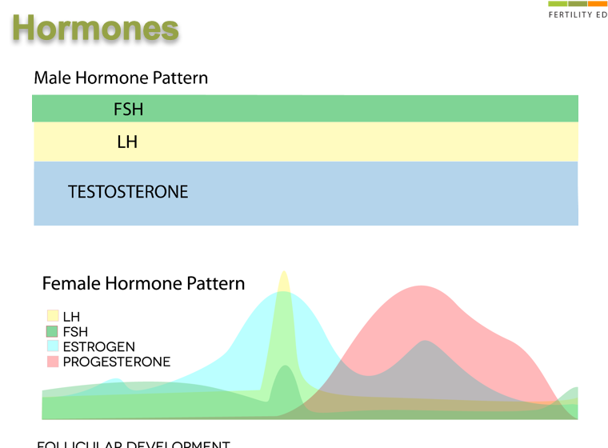
Hormones

Slide 16
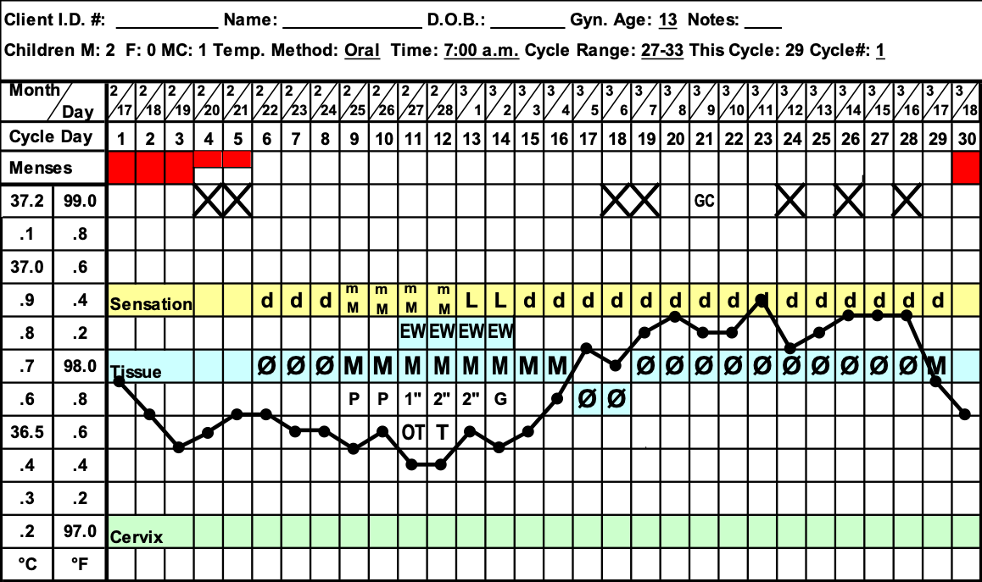
Typical Sympto-Thermal Chart
Notes:
The woman’s waking temperature, undisturbed by activity, is known as the Basal Body Temperature and can be taken daily each morning and charted. Under normal conditions and following a good night’s rest it is the lowest temperature she will experience daily.
It is one of the signs checked in the Symptom-Thermal method of NFP.
After ovulation, the corpus luteum produces a level of progesterone, the hormone which will affect the temperature regulating system in the brain, and a woman will see a rise in her temperature. If she is not pregnant her temperature will drop toward the end of her cycle due to a rapid decrease in her progesterone and estrogen levels.
If she is pregnant the temperature will stay elevated through much of her pregnancy and in fact a sustained high temperature phase of 18-21 high temperatures will be an early sign of pregnancy.
Taking the temperature and seeing a sufficient and sustained rise confirms that ovulation has taken place in a cycle and will also inform a woman if she has not yet ovulated if a temperature rise has not yet occurred.
What does this sound like? An incubator has increased temperature to help babies. It is something like that.

Slide 17

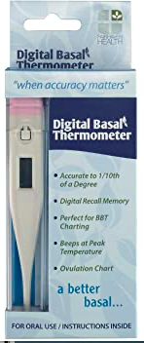
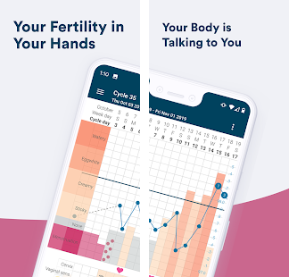
Tools for S-T Method
KINDARA APP
Notes:
Over 7.6K reviews, 1.6 million subscribers to KINDARA
BASAL digital thermometer

Slide 18
Ovulation Method Chart
Notes:
This is a chart for another NFP method that we offer from the Office of NFP, called Billings Method, or Ovulation Method, where the symptom of the temperature is not taken.

Slide 19




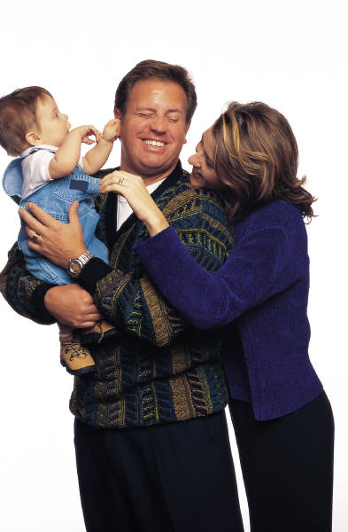


Achieving Pregnancy
Notes:
Couples practicing NFP to achieve pregnancy have the opportunity to discover the awesome gift they possess in becoming co-creators with God as a new life is produced resulting from their union on known fertile days.
They can more accurately calculate their baby’s due date since the approximate time of conception is known. They have a better opportunity to protect their baby’s healthy development due to an earlier confirmation that pregnancy has occurred and they can enjoy the benefits of sharing as a couple the decisions related to planning their family.

Slide 20
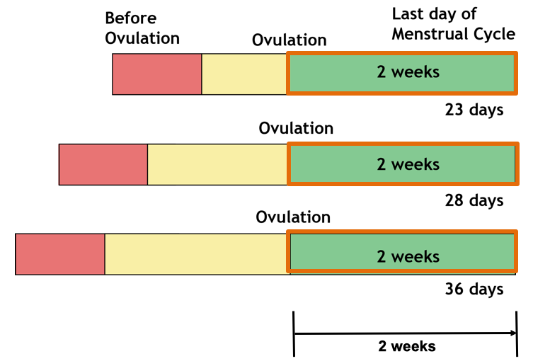
When does ovulation occur?

Slide 21
Conception
Notes:
Conception - Beginning of Life
We see here the process leading toward conception. When intercourse takes place during the fertile time, the cervical mucus present in the vagina helps to transport the sperm upward into the cervix and the Fallopian Tubes. Conception, the fertilization of the egg by sperm, occurs here, in the upper third of the Fallopian Tube and requires three things:
viable sperm in the Fallopian tube
favorable mucus to allow the sperm to get there
an egg released within the last 24 hours
At conception a unique human individual or embryo forms from the intertwining of DNA molecular strands from the sperm and ovum. At this point the DNA is active and begins a rapid process of organizing nutrition, cell division and differentiation of different types of cells. Indeed, after the first twenty cell divisions, there are thousands of cells.

Slide 22
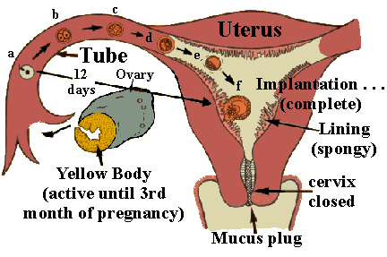
Implantation
c
b
Uterus
d
a
Tube
e
Ovary
12
days
f
Implantation (complete)
Lining
(Spongy)
Yellow Body
(Active until 3rd month
of pregnancy)
Cervix
Closed
Mucus Plug
Notes:
Tiny hairs on the inside of the Fallopian tube, called cilia, move the embryo toward the uterus, a journey that takes approximately 7-10 days. There the embryo implants in the endometrium. The embryo is not just a mass of cells, but a highly diversified individual human being. Three different types of cells , ectoderm, mesoderm and endoderm are already functioning in ways that will form all the systems of the human body.
Note: The “Yellow Body”, or corpus luteum, the former housing for the egg, actively produces a hormone which:
Impacts a change in fertile signs signaling ovulation as passed,
Continues support of the uterine lining if pregnancy has occurred and
Suppresses further ovulation until the birth of the child.
The cervical mucus has formed a plug at the mouth of the cervix to protect a new pregnancy, if it has been achieved, by preventing additional sperm or bacteria from entering the uterus.

Slide 23
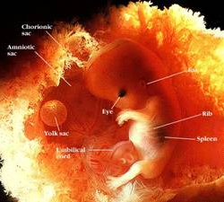
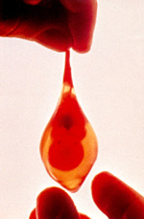
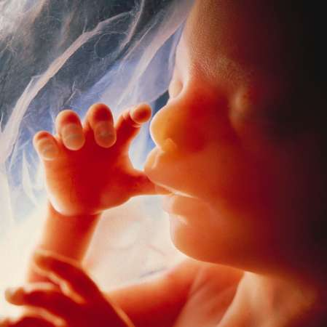
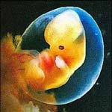
12 weeks
6 weeks
Chorionic
sac
Amniotic
sac
Ear
Eye
Rib
Yolk sac
Spleen
Umbilical
cord
24 weeks
5 weeks
Notes:
**Dr. Bernard Nathanson—saw a tubal pregnancy baby like this one at 6 weeks, alive and stopped aborting babies.
At 8 weeks of fetal development this child is just about 1” long. Everything is present that will allow full adult development. The heart has been beating for about a month, the stomach is producing digestive juices and the kidneys are functioning. Many sets of muscles receive nerve stimulation. This baby responds to its mother’s touch even though she cannot yet feel her child’s movement.

Slide 24
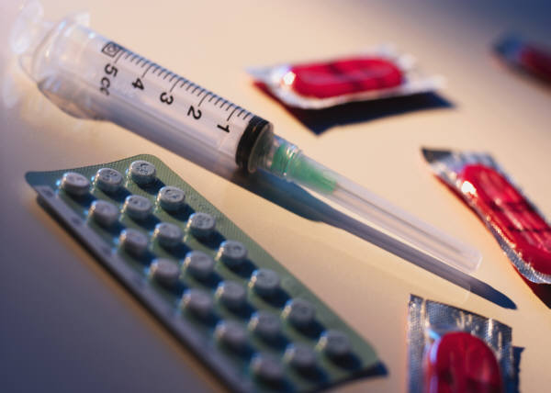
Types of Contraception
Barriers
Chemicals
Devices
Withdrawal
Notes:
At this point we will examine how contraceptives work.
Barriers: Condoms, diaphragms, cervical caps, vaginal sponges, and spermicides.
Action: designed to physically or chemically prevent the union of a sperm & an egg. All of these barriers require a couple to gear up to “ protect” themselves from the other’s fertility, rather than to unite completely in an act that should be a complete self-donation through marital intercourse. Side effects range from allergies to bladder infections and the effectiveness of the methods is rather low.
Chemicals ( synthetic hormones): Birth Control Pills (OCPs), Injectables or “shots” such as Lunelle or Depo-Provera, transdermals such as the Patch, Vaginal Rings, Emergency Contraception( Morning After Pill) and subdermal implants such Norplant (no longer being inserted).
All are both contraceptive and abortifacient in their methods of action.
Action:
Inhibition of ovulation
Changes in the cervical mucus to make it thicken (which increases the difficulty of sperm entry into the cervix)
Tubal motility is changed, affecting the sperm and egg movement through the Fallopian tubes.
Depletion of the endometrium which reduces the likelihood of implantation of a blastocyst, causing an early abortion.
It is known that even though using these contraceptives, breakthrough
ovulation is known to occur approximately 2-8% of the time
and therefore pregnancy is possible. If pregnancy does occur, the newly
conceived life is unable to implant in the uterus due to the
chemically induced changes. These chemicals therefore have the
potential to be abortifacient, or causing an early abortion, happening
before a woman even realizes she is pregnant.
*( Bronson, RA. “ Oral Contraception: mechanism of action.” Clinical Obstetrics and Gynecology, 1981.; Killick, Fitzgerald, American Journal Obstetrics and Gynecology 1998)
Side Effects: In addition to this little-known potential abortifacient effect, using these chemicals disrupts a normally functioning reproductive system occurring in the woman’s body. They also produce many side effects ranging from mild to severe and are too numerous to list, but range from menstrual difficulties to bone density loss, cancers, tumors, heart disease, and depression.
Important to note: There is a definite link that has been shown to the later development of breast cancer. In fact, the results of a 2006 Mayo Clinic investigation show an over-all 19% increased risk for premenopausal breast cancers in women who used birth control pills. For those women who began pill use prior to their first full term pregnancy the risk jumps to 44 %.
(Full study: www.mayoclinicproceedings.com/pdf/8110/8110a1.pdf) In addition, since 2005, the World Health Organization classifies oral contraceptives as “ highly carcinogenic.”)
Devices: IUDs, Vaginal Rings( also a chemical form of contraceptive)
Actions:
IUDs – polyethylene or copper objects inserted into the uterus. Some have a silicone tube containing hormones and some have copper both designed to interfere with fertilization through impact on sperm motility or changes in the cervical mucus. They do not inhibit ovulation. These devices are therefore considered potentially abortifacient because they act mechanically to prevent a pregnancy, should it occur, from implanting in the uterus where it must live and grow to survive.
They can also cause ectopic pregnancies, increased menstrual bleeding, increased risk of Pelvic Inflammatory Disease, which can lead to infertility.
Vaginal Rings –are rings made of a synthetic material containing chemicals and inserted into the vagina. The intended action is to prevent ovulation as well as increase the difficulty of sperm motility and promote change in the endometrium reducing the likelihood of implantation should a pregnancy occur.
Thus, they also have the same potential of acting as abortifacients and the same risks associated with the pill.
Please make sure you double check these assertions. A good source: PDR – Physicians’ Desk Reference – www.PDR.net)
Withdrawal
Withdrawal as a means of contraception is regarded as having a low effectiveness rate and is not considered a moral practice as it separates the unitive and procreative elements when ejaculation intentionally takes place outside the vagina.
Please refer to the brochure “The Family Planning Decision” which you have received in your folder for other information about the mild to severe side-effects, cost and general information about contraceptives.
Other means which are not contraceptive but act to prevent or terminate the life of a child include:
Sterilization: defined as surgical intervention which inhibits normal reproductive function. It can be reversed but is quite expensive and is often unsuccessful. You can get further information regarding this in the brochures given in your folders.
Both contraception and sterilization regard the gift of fertility as something to be disposed of, treated as a disease or obliterated.
Abortion is defined as the willful termination of a pregnancy. This is accomplished chemically by drugs such as RU 486 or surgically through abortion.
Emergency Contraception or “the Morning after Pill” which is an extremely high dose of the birth control pill and is now available without prescription for 17 year olds! (Preven EC) has three actions:
1. Prevention of ovulation (if it has not yet occurred)
2. Disruption of fertilization (joining of the sperm and egg)
3. Inhibition of implantation (attachment of a fertilized egg to the uterus)
It therefore also has abortifacient potential.

Slide 25
Relationship Differences
Fertility Awareness
Shared responsibility
Enhances couple communication
Abstain if avoiding pregnancy
Fosters mutual respect
Connects intimacy with pregnancy
Contraception
Individual responsibility
Diminishes need for communication
Engage while avoiding pregnancy
Creates environment to “use” partner
Separates sex from pregnancy
Natural Family Planning
Moral Differences
Unitive & procreative elements present
Conscious choice to engage in or avoid sexual intercourse during fertile times
Promotes viewing fertility as a gift
Promotes idea of “children as gift”
Promotes self mastery, maturity, generosity
Fosters acceptance to new life and unplanned pregnancy
Fosters responsible sexual behavior
Contraception
Moral Differences
Unitive and/or procreative elements absent
Often unaware if fertile or infertile which necessitates continuous contraception
Treats fertility as a disease
Encourages attitude of “children as burden”
Promotes selfishness, immaturity
May resort to abortion if pregnancy occurs
Pill, Patches, Implants, Rings, Injectables, and IUD, act as abortifacients
Enables irresponsible sexual behavior
Natural Family Planning
Effectiveness Rates
Sympto-Thermal and Ovulation methods have up to 99% effectiveness rate if properly learned and used according to instructions for avoiding or delaying pregnancy.
Contraception
Effectiveness Rates
Pill, patch, rings = 92%
Injectables = 97%
IUD = 98-99%
Diaphragm = 84%
Cervical Cap = 68-84%
Condoms = Male-85%, Females-79%
Spermicides-71%
Withdrawal 73%
Surgical Sterilization = 99%
Natural Family Planning
Medical Differences
No health risks to woman from use
Harmless to child if conception occurs while using
Works with fertility cycles and for all women in any phase of reproductive life
No impact on future fertility
Contraception
Medical Differences
Possible physical side effects to woman from use
May lead to early abortion if child is conceived while using
Suppresses or eliminates fertility
May impact future fertility
Notes:
A question we re-visit now: “If the end is the same (the end being the spacing or limiting the number of children in our family) then what is the difference between using Natural Family Planning, contraception or perhaps even sterilization?

Slide 26
Medical Differences
Natural Family Planning
Relational Differences
Encourages shared responsibility
Enhances couple communication
Abstain from sex if avoiding pregnancy
Fosters mutual respect
Acknowledges that sexual intercourse may result in pregnancy
Promotes growth/longevity of marriage
Contraception
Relational Differences
Is primarily an individual responsibility
Lessens need for discussion
Engage in sex while avoiding pregnancy
Creates environment to “use” partner
Mentally and physically separates connection between sex and pregnancy
May result in promiscuity, infidelity and divorce
Natural Family Planning
Moral Differences
Unitive & procreative elements present
Conscious choice to engage in or avoid sexual intercourse during fertile times
Promotes viewing fertility as a gift
Promotes idea of “children as gift”
Promotes self mastery, maturity, generosity
Fosters acceptance to new life and unplanned pregnancy
Fosters responsible sexual behavior
Contraception
Moral Differences
Unitive and/or procreative elements absent
Often unaware if fertile or infertile which necessitates continuous contraception
Treats fertility as a disease
Encourages attitude of “children as burden”
Promotes selfishness, immaturity
May resort to abortion if pregnancy occurs
Pill, Patches, Implants, Rings, Injectables, and IUD, act as abortifacients
Enables irresponsible sexual behavior
Natural Family Planning
Effectiveness Rates
Sympto-Thermal and Ovulation methods have up to 99% effectiveness rate if properly learned and used according to instructions for avoiding or delaying pregnancy.
Contraception
Effectiveness Rates
Pill, patch, rings = 92%
Injectables = 97%
IUD = 98-99%
Diaphragm = 84%
Cervical Cap = 68-84%
Condoms = Male-85%, Females-79%
Spermicides-71%
Withdrawal 73%
Surgical Sterilization = 99%
Fertility Awareness
No health risks
Works with fertility
No impact on future fertility
No environmental impact
Contraception
Potential side effects
Suppresses or eliminates fertility
May impact future fertility
Environment impacted by artificial hormones in waterways

Slide 27
Effectiveness Rates
Fertility Awareness
Sympto-Thermal and Ovulation Methods – 99%
*if properly learned and used according to instructions for avoiding or delaying pregnancy
Contraception
Pill, patch, rings - 92%
Injectables - 97%
IUD - 98-99%
Diaphragm - 84%
Cervical Cap - 68-84%
Condoms: Male-85%
Female-79%
Spermicides - 71%
Withdrawal - 73%
Surgical Sterilization - 99%

Slide 28





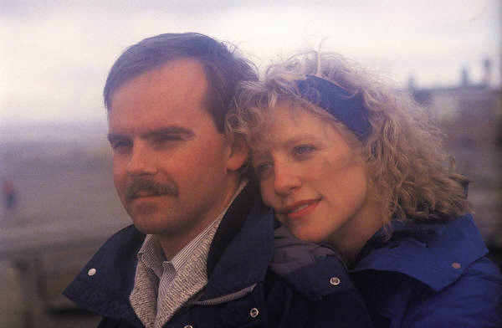








The Effectiveness of NFP Depends on You
Notes:
Scientific studies of women’s menstrual cycles have produced conclusive evidence of NFP’s effectiveness. A recent 2007 study published in the journal Human Reproduction found the effectiveness of the Sympto-Thermal Method was 99.6%, while the most recent figures from a long term study of the Ovulation Method in China yielded a 99.5% effectiveness rate.
We have also provided a brochure A Family Planning Decision in your Introduction packet where you can look at the effectiveness rates from other studies and the sources for those statistics. As you can see, NFP compares quite favorably with the rates quoted for contraceptive use. Affecting those rates for all contraceptives as well as for NFP are factors such as:
Motivation
Understanding of proper use
Following directions
Neither NFP nor contraceptives claim 100% effectiveness to avoid pregnancy.

Slide 29



2 Important Questions
What is the purpose of INTERCOURSE?
1. 2.
What is the purpose of MARRIAGE?

Slide 30



NFP Respects Marital Love
“NFP empowers a couple constantly to be mindful of the ‘community of love’ that the Church calls them to celebrate in their home, and enables them to always see their children – those already born and those yet to be – in their lover’s eyes.”
Dr. Gregory Popcak, “Beyond the Birds and the Bees”, p.187

Slide 31
Online Education
Ovulation Methods
Billings: www.learnnfponline.com
Creighton: www.fertilitycare.org
Sympto-Thermal Methods
SymptoPro: www.symptopro.org
Couple to Couple League: www.ccli.org
Sympto Hormonal
Marquette: www.vitaefertility.com

Slide 32

The Grace of the Sacrament

Slide 33
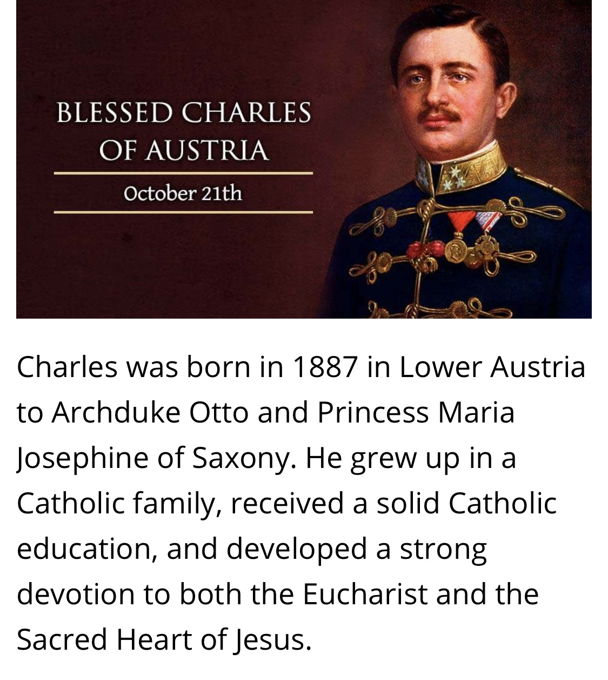
Emperor Charles of Austria:
Last ruler of Austro-Hungarian Empire
W

Slide 34
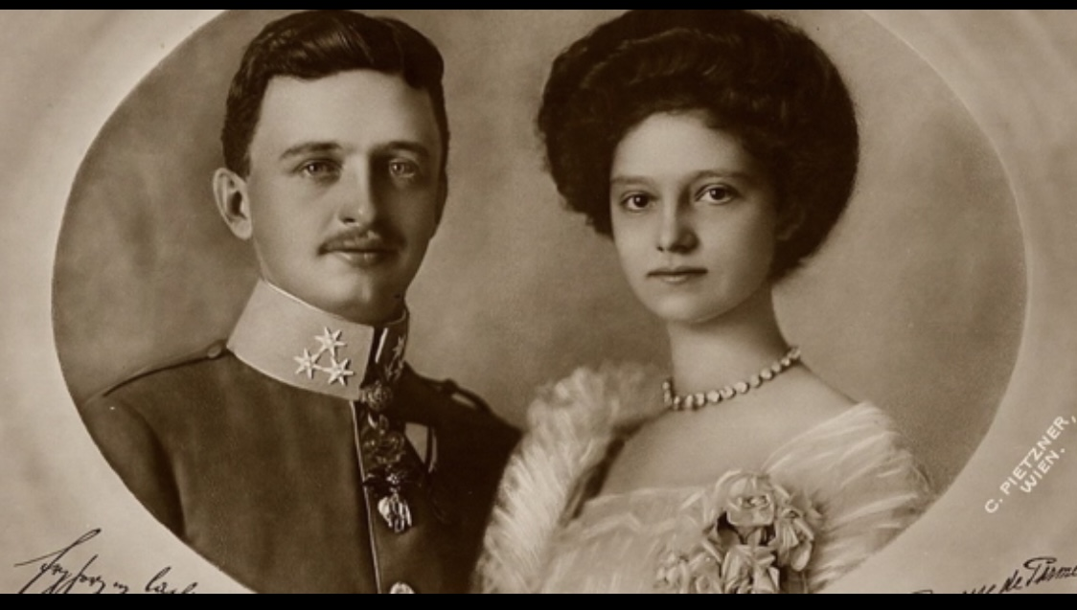
Blessed Charles (Karl) & Zita

Slide 35
Marriage Tips from Blessed Charles and his bride, Zita
Remember the primary goal of marriage is to help each other get to heaven.
Entrust your marriage to the Blessed Virgin Mary.
Work together as a team.
Keep marriage & family a priority.
Choose to love each other even in midst of suffering.

Slide 36
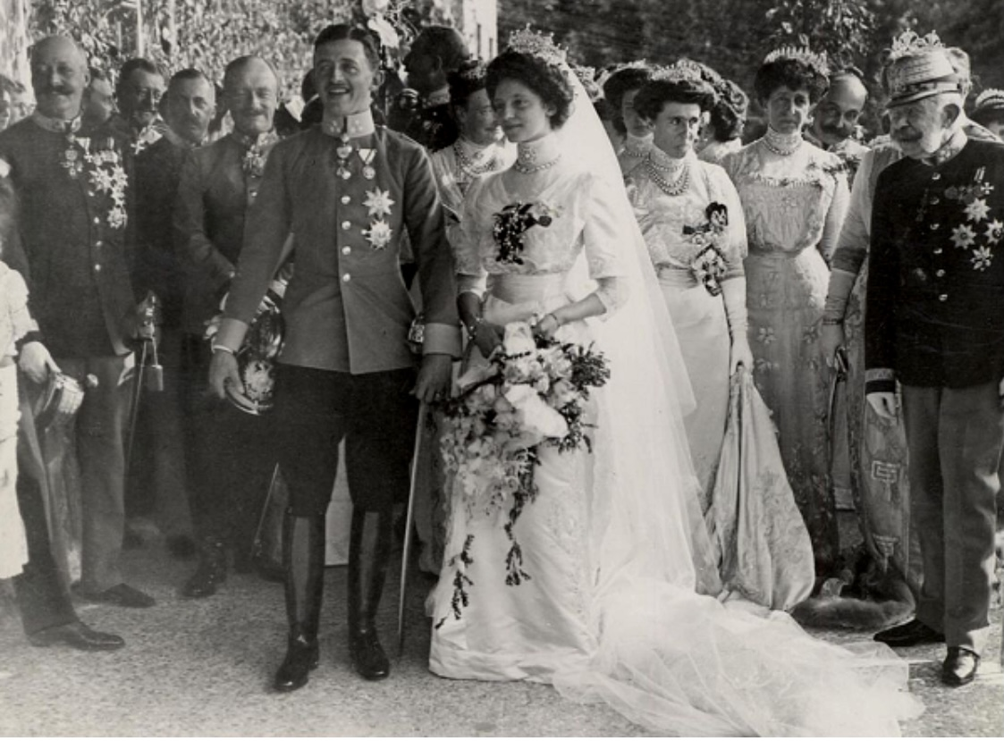
Wedding of Emperor Charles & Princess Zita
October 21, 1911

Slide 37
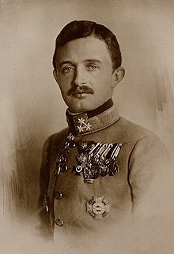
Emperor Charles declared “Blessed” by Pope John Paul II in 2004
The “Peace” Emperor unsuccessfully attempted to end World War I and was exiled to the island of Madeira. He died shortly after in 1922. His wife, Zita lived another 67 years. JP II’s father named his son after Emperor Charles.

