Slide 1
Natural Family Planning
THEN & NOW

Slide 2
Topics to Reviewed
Overview of the History of NFP
Review of NFP Methods
Similarities and differences

Slide 3
NFP HISTORY
1930
LAMBETH CONFERENCE
Anglican bishops break from unanimous Christian tradition
and allow artificial birth control.
Notes:
First time a Christian denomination (Anglican) opened the door to permitting the use of Artificial Contraception for “grave reasons”. By 1960-1970, almost all Protestant Churches had approved use of artificial contraception.

Slide 4
NFP HISTORY
Dr. Knaus & Dr. Ogino
Dr. John Smulders
1930
CALENDAR RHYTHM
Notes:
Dr. Knaus (Austria) and Dr. Ogino (Japan) were both gynecologists who discovered that ovulation typically happens 14 days before onset of menses. Dr. Smulders was a Catholic doctor from Netherlands. Smulders used the Knaus-Ogino info to create a method to avoid pregnancy and published his work w/ the Dutch Catholic Medical Association. This became known as calendar rhythm.

Slide 5
NFP HISTORY
1935
CALENDAR RHYTHM
+
TEMPERATURE
Fr. Wilhelm Hillebrand
Notes:
Hillebrand was a German Catholic priest w/ a scientific mind (father and brothers were physicians) who wanted to help his parishioners. He advised couples on the use of CR but soon had reports of 3 unplanned pregnancies. He was aware of new temp-based research. His genius was insisting that post-ovulatory infertility was dependent on elevated temps. He invented the Calendar-Temperature Method (shortest cycle-19 days).

Slide 6
NFP HISTORY
Dr. Holt
Dr. Doering
1950s-1960s
TEMPERATURE*
*Standardized Temperature for the first time
Notes:
Published temperature only studies prior to Humanae Vitae. Dr. Prem used temp to establish EDC.

Slide 7
Symptoms
NFP HISTORY
X
1950s-1960s
+
TEMPERATURE
Drs. John & Evelyn Billings
BOM, WOOMB
Symptoms = Cervical Fluid
Symptom Standardization
for the first time
10 Years
Notes:
Abandoned the use of temp taking in their model after 10 years, due to difficulty teaching illiterate women temp taking methods. They wished to provide a method that could be used effectively internationally. All NFP methods draw from the studies of Billings.

Slide 8
NFP HISTORY
1968
HUMANAE VITAE
Pope Paul VI
(also Archbishop Karol Wojtyla : Pope John Paul II)
Notes:
Wojtyla was appointed to Papal Commission in Rome but he was denied a passport. So he created a commission in Krakow (soon to become the Institute of Family Studies). He tried to develop a new framework for the Church’s teaching on conjugal morality and much of this (40%) is contained in Humanae Vitae. Humanae Vitae did NOT adopt the rich personalist (philosophically well-developed Christian humanism) context suggested by Krakow Commission. Despite its affirmation of traditional teaching on sexual morality, many considered it pastorally insensitive and legalistic.

Slide 9
NFP HISTORY
John & Sheila Kippley
CCLI
* Ecological Breastfeeding
1970s
Symptoms
+
TEMPERATURE
+
OTHER
Notes:
Seven Standards of ecological breastfeeding. Initiated Sympto-Thermal education.

Slide 10
NFP HISTORY
Mercedes Wilson
FAF - Modified version of Billings
Spanish
1977
Symptoms
Notes:
Worked for Billings. Wanted to develop an easier method for teaching NFP in Third World Countries. Peoples Republic of China:98-99% effectiveness. Dedicated to defending the rights of the family. Guatemalan delegate to Cairo Conference, Copenhagen, Bejing, Istanbul, and Rome. Appointed to Pontifical Academy for Life.

Slide 11
NFP History
1981-1985
Symptoms
Applied letter/number codes to Billings to enhance standardization
Dr. Thomas Hilgers
Creighton / NaProTechnology
Pope Paul VI Institute
Notes:
Established AANFP now called AAFCP (American Academy of Fertility Care Professionals),

Slide 12
NFP HISTORY
Rose & Mike Fuller
Msgr. Huneger
Dr. Josef Roetzer
NWFS: SymptoPRO
1983
Symptoms
+
TEMPERATURE
+
OTHER
Notes:
Huneger is a priest who worked w/ the Fullers relying heavily on the Sympto-Thermal research of Dr. Roetzer (Austria)

Slide 13
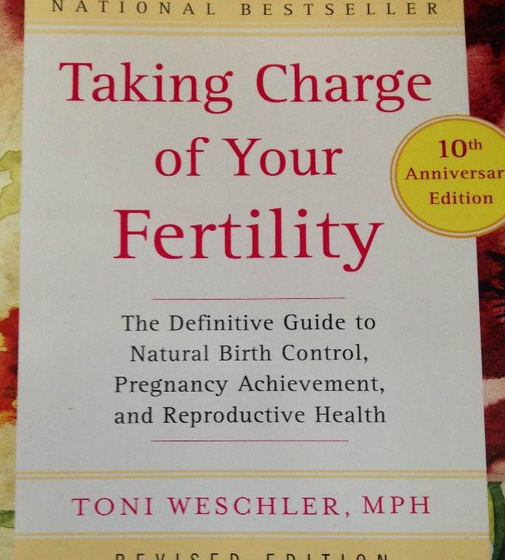
NFP HISTORY
Toni Weschler
FAM
1985
Symptoms
+
TEMPERATURE
+
OTHER
Notes:
Toni Weschler holds a Masters Degree in Public Health. Ovusoft is her website. First to encourage the use of the term “Fertility Awareness Methods” vs. NFP. Began speaking tour in many secular outlets in 1985 and released TCOYF in 1995. 20th Anniversary addition coming out this July. Secular version of NFP.

Slide 14
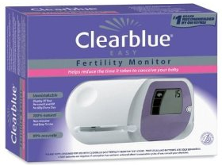
NFP HISTORY
Dr. Richard Fehring
Marquette Model
1997
Symptoms
+
TEMPERATURE
+
HORMONAL MONITOR
Notes:
Dr. Fehring also co-authored the book AN INTRODUCTION TO NATURAL FAMILY PLANNING. Marquette Model is close to releasing their own mobile app (perhaps this summer 2015).

Slide 15
NFP HISTORY
John & Sheila Kippley
NFPI
* Ecological Breastfeeding
2004
Symptoms
+
TEMPERATURE
+
OTHER

Slide 16
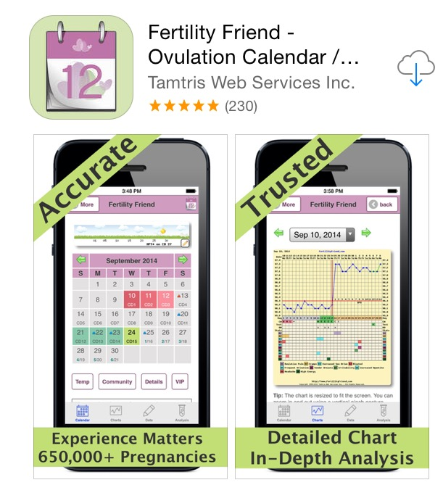
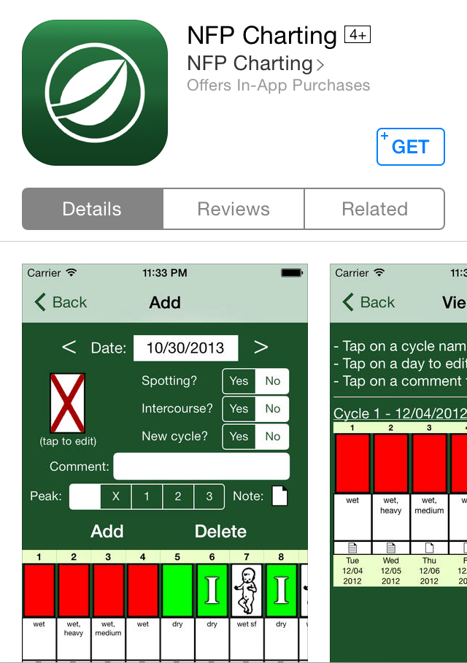
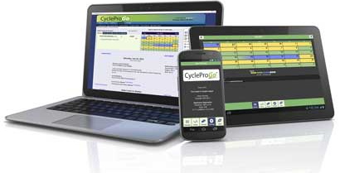
Fertility Tracking Apps
Notes:
Fertility Friend (secular), NFP Charting (made to work w/ Billings but not designed by them but by a Baptist who teaches the method), CycleProGo (CCLI)

Slide 17
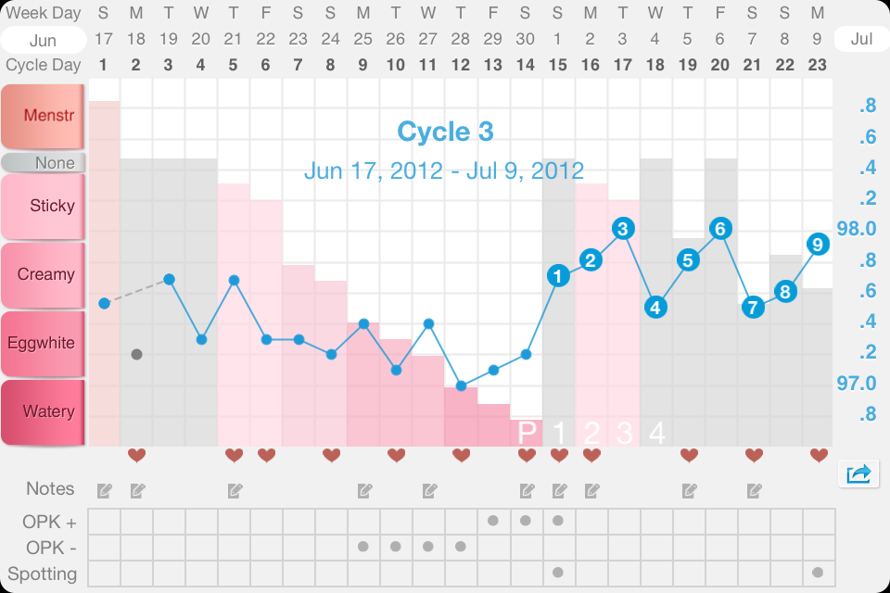
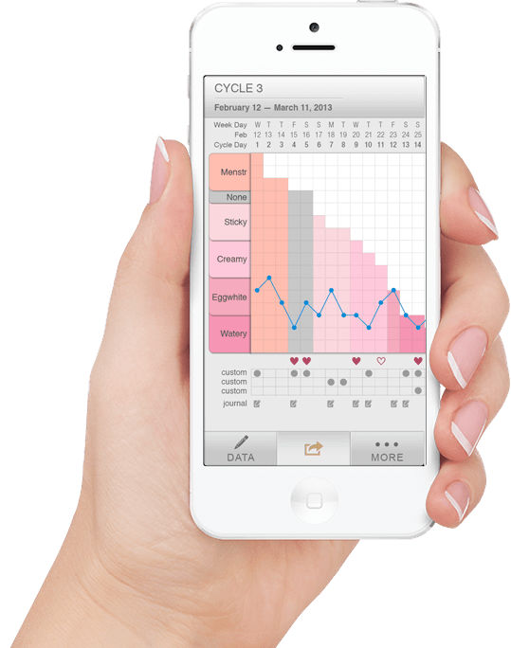
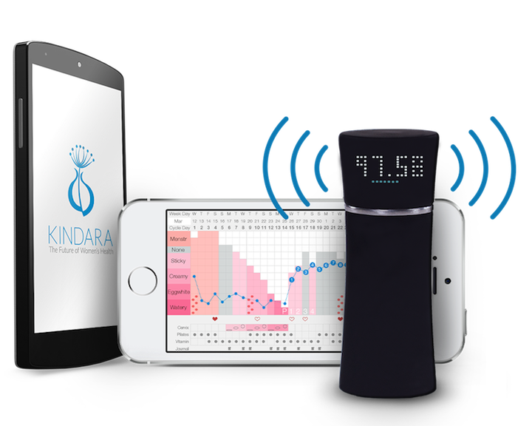
Fertility Charting Apps
Notes:
Kindara-best reviews of a secular app. Wink is the alarm/thermometer that is coming out soon ($70) that is blue-toothed to your mobile device.

Slide 18
Reasons to Use NFP
Philosophical/Religious
Moral/Ethical
Psychological
Biological
Notes:
Law of gradualness

Slide 20
NFP Methods Review

Slide 21
NFP Methods
Symptoms (Ovulation Methods)
Billings (BOM, WOOMB)
Family of the Americas Foundation (FAF)
Creighton / Napro Technology
Sympto-Thermal
Couple to Couple League (CCLI)
Northwest Family Services (NWFS) SymptoPro
NFP International (NFPI)
Sympto-Thermal + Hormone Monitor
Marquette Model (MM)
Notes:
Ovulation Method: #1 method internationally Sympto-Thermal Method: #1 method nationally

Slide 22
Common to all Methods
Standardized & backed by studies verifying effectiveness >99%
Certified teacher training
Useful to achieve or avoid pregnancy
Useful throughout ALL stages of a woman’s reproductive life
Useful w/ regular & irregular cycling as well as breastfeeding
Helpful to identify patterns of infertility

Slide 23
Main differences
Cost of classes vary ($75-$400). Online ~ $100.
Some methods have computer charting and smart phone apps.
Creighton assists w/connecting to local physicians who will not promote immoral reproductive technologies.
Some methods offer online classes for convenience of couples (via Skype or Powerpoint).
Most classes are taught in group setting w/ individual, private charting assistance after class. Creighton is typically taught one on one.
Titles vary: teachers, instructors, practitioners, educators… * ALL are certified.
Marquette Method- only taught by nurse/ health care professional.

Slide 24
Additional Benefits
Shared responsibility
No harmful side effects
Promotes mutual understanding
Fosters respect for the total person
Honors design of woman’s body/respects natural law
Low cost….BCP~ $1800/5 yrs
Lower divorce rate

Slide 25
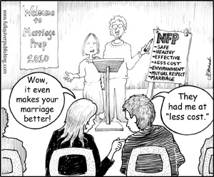
Additional Benefits

